Slide 1
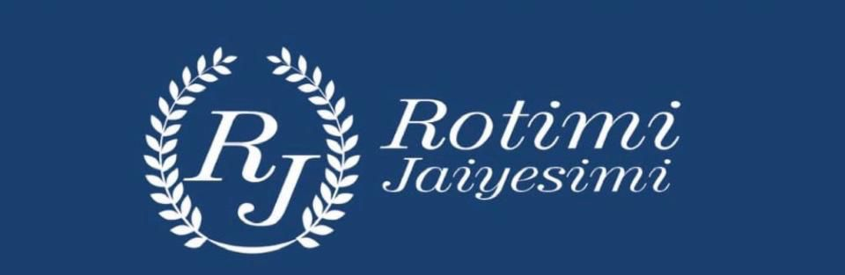

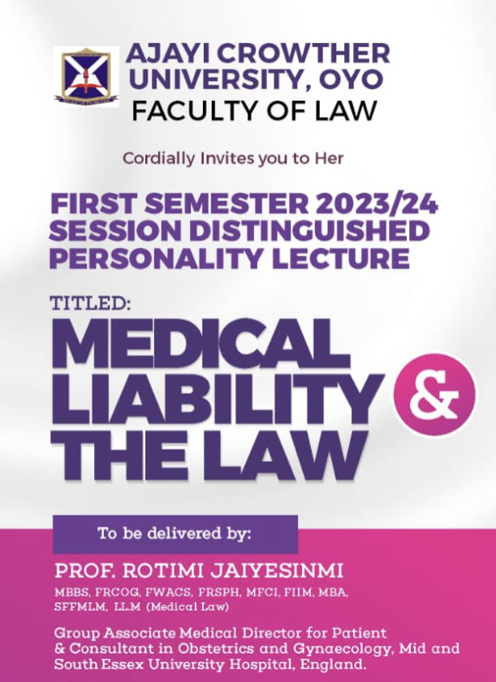

Slide 2
Medical Liability and the Law
Prof Rotimi Jaiyesimi
MBBS, MFCI, FRSPH, FWACS, FRCOG, FIIM, MBA, SMFMLM, LLM (Medical Law)
Group Associate Medical Director for Patient Safety
Consultant Obstetrician & Gynaecologist
Visiting Professor, Faculty of Law, University of Ibadan
Global Health Expert
Senior Member Faculty of Medical Leadership and Management
17 October 2023

Slide 3

Law and Medicine
A personal interest that underpins good practice
Visiting Professor, Faculty of Law
University of Ibadan
International Expert Medical Witness
England
Scotland
Northern Ireland
Republic of Ireland
Trinidad and Tobago

Slide 4
Medical Liability and the Law
Outline
Introductions
Acknowledgments
Declaration of Interests
Medical Liability and the Law
Conclusion

Slide 5
Medical Liability and the Law
Musa, Chinyere, Sola

Slide 6
Medical Liability and the Law
The Practice of Medicine
To practice in Nigeria, doctors must be registered with the Medical and Dental Council of Nigeria
The Duties of a Doctor
Patients must be able to trust medical professionals with their lives and health.
To justify that trust, doctors must make the care of patients their first concern, and meet the standards expected of each doctor in these areas:
  Knowledge, skills and development
  Patients, partnership and communication
  Colleagues, culture and safety
  Trust and professionalism

Slide 7
Medical Liability and the Law
The Duties of a Doctor
  Knowledge, skills and development
  Provide a good standard of practice and care, and work within your competence.
  Keep your knowledge and skills up to date.
  Patients, partnership and communication
  Respect every patient’s dignity and treat them as an individual.
  Listen to patients and work in partnership with them, supporting them to make informed
  Decisions about their care.
  Protect patients’ personal information from improper disclosure.
  GMC, Good Medical Practice, 2024

Slide 8
Medical Liability and the Law
The Duties of a Doctor
  Colleagues, culture and safety
  Work with colleagues in ways that best serve the interests of patients, being willing to lead or follow as circumstances require.
  Be willing to share your knowledge, skills and experience with colleagues, whether informally or through teaching, training, mentoring or coaching.
  Treat people with respect and help to create a working and training environment that is compassionate, supportive and fair, where everyone feels safe to ask questions, talk about errors and raise concerns.
  Act promptly if you think that patient safety or dignity may be seriously compromised.
  Take care of your own health and wellbeing needs, recognising and taking appropriate action if you may not be fit to work.
  GMC, Good Medical Practice, 2024

Slide 9
Medical Liability and the Law
The Duties of a Doctor
  Trust and professionalism
  Act with honesty and integrity: Be open if things go wrong.
  Protect and promote the health of patients and the public.
  Never unfairly discriminate against patients or colleagues.
  Never abuse patients’ trust in you or the public’s trust in your profession.
  GMC, Good Medical Practice, 2024

Slide 10
Medical Liability and the Law
Doctors whose Practice has been Called into Question

Slide 11
Medical Liability and the Law
Registration, Regulation and Compliance

Slide 12
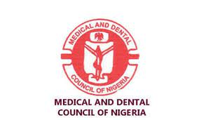
Medical Liability and the Law
Medical and Dental Council of Nigeria (MDCN)
The Medical and Dental Council of Nigeria (MDCN), established in 1963, is a professional health regulatory agency for the professions of Medicine, Dentistry and Alternative Medicine in Nigeria.

Slide 13

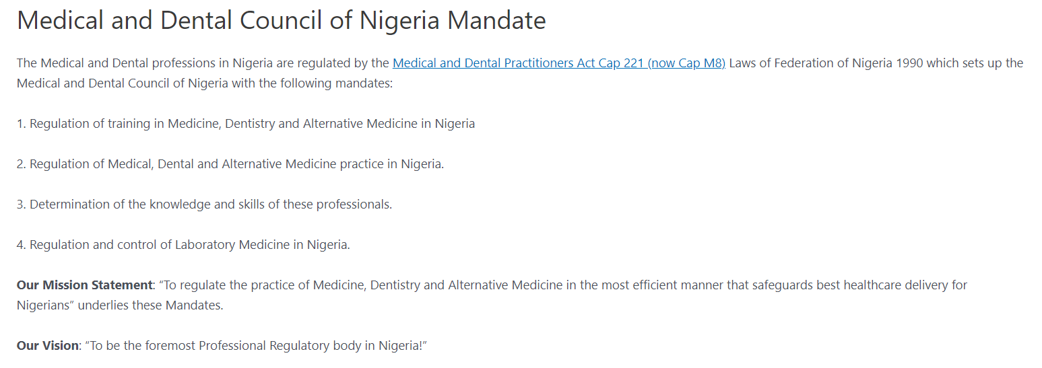
Medical Liability and the Law
Not explicitly stated to keep patients safe

Slide 14
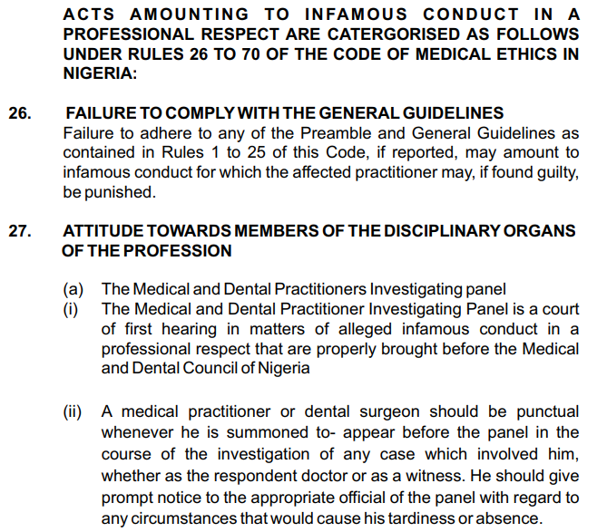
Medical Liability and the Law

Slide 15
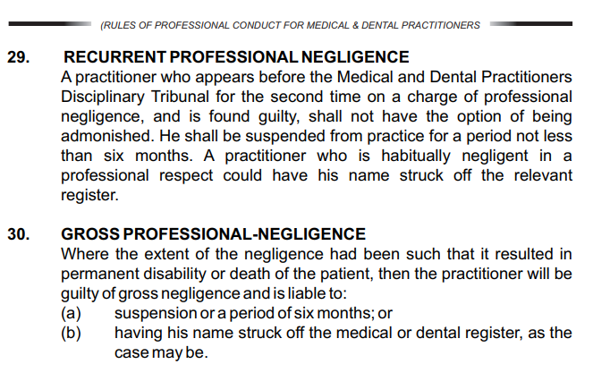
Medical Liability and the Law
6 months: Your views?

Slide 16
Medical Liability and the Law
Rules of Professional Conduct for Medical and Dental Practitioners Act, Cap 221, Laws of the Federation of Nigeria 1990
REGULATION OF MEDICAL AND DENTAL PRACTICES IN NIGERIA
The Medical and Dental Professions in Nigeria are regulated by the Medical and Dental Practitioners Act Cap 221 Laws of the Federation of Nigeria, 1990 (as amended), which set up the Medical and Dental Council of Nigeria and with the following responsibilities:
A. Determining the standard of knowledge and skill to be attained by persons seeking to become members of the medical or dental profession and reviewing those standards from time to time as circumstances may permit.
B. Securing in accordance with provisions of the Act the establishment and maintenance of register of persons entitled to practise as members of the medical or dental profession and the publication from time to time of lists of those persons;
C. Reviewing and preparing from time to time, a statement as to the code of conduct which the Council considers desirable for the practice of the professions in Nigeria,
D. Performing the other functions conferred on the Council by the Act.

Slide 17
Medical Liability and the Law
Rules of Professional Conduct for Medical and Dental Practitioners in Nigeria which was first published in 1963. It was revised in 1995. A new edition has been published as Code of Medical Ethics in Nigeria since January 2004.

Slide 18
Medical Liability and the Law
Medical Liability

Slide 19
Medical Liability and the Law
MEDICAL LIABILITY
Medical liability refers to the legal responsibility healthcare professionals have towards their patients. It encompasses both civil and criminal liability for any harm or injury caused during the provision of healthcare services.
The scope of medical liability includes
  professional negligence
  product liability
  breach of confidentiality
  informed consent, and more
Example
Consider a scenario where a surgeon operates on a patient and unintentionally leaves a surgical instrument inside the patient's body. This constitutes a breach of the duty owed by the surgeon, leading to potential medical liability.

Slide 20
Medical Liability and the Law
Negligence v Professional malpractice
If negligence element is proven, the penalty is usually financial
Prison sentence if there is a criminal to it (wilful neglect) or no consent (battery)
This is separate from the regulatory bodies such as the MDCN, Pharmaceutical Council, Nursing Council
The outcome of these proceedings include retraining, suspension, striking off the register

Slide 21
Medical Liability and the Law
The Doctor before the Investigating Panel of the MDCN
The IP has legal backing

Slide 22
Medical Liability and the Law
Communication
A survey of why patients and their relatives pursue negligence claims in Nigeria show that lack of good communication, insensitive handling of the adverse incidents, arrogance play important roles
(L Kohn et al. To err is human: Building a safer health system, 2000)
Giving Apologies (not admitting negligence)
In MDPIP Vs Dr Onaiwu, Charge No MDPTDT/29/2005, one of the doctors involved was sanctioned when no apology was given to the daughter of a patient who died under their care
An apology is not stricto sensu an admissibility of liability at law

Slide 23
Medical Liability and the Law
The Doctor before the Courts
For Malpractice

Slide 24
Medical Liability and the Law
Malpractice - Improper, unskilled, or negligent treatment of a patient by a doctor, dentist, nurse, pharmacist, or other health care professional
Medical Negligence - is the predominant theory of liability concerning allegations of medical malpractice, making this type of litigation part of Tort Law
Medical malpractice lawyers investigate the claim
Medical expert witness provide reports to help the Court understand the events in the management of the patient

Slide 25
Medical Liability and the Law
TORT LAW
● Tort Law is the law dealing with wrongs such as Injury or damages during surgery and is considered personal injury
● The patient believe they have been wronged and seek redress in the Courts
The Legal Process (Nigeria)
● It is a civil (and not criminal) proceeding
● The Standard of Proof is based on the balance of probabilities
● It is heard by the Investigating Panel (IP) of the Medical and Dental Practitioners Disciplinary Tribunal
● It is for the Claimant to prove the case
● The Claimant can appeal the MDPDT decisions at the Court of Appeal and the Supreme Court of Nigeria

Slide 26
Medical Liability and the Law
The Legal Process (Nigeria)
● Claimant and Defendant, through Solicitors, instruct medical experts
● The role of the medical expert is to produce a report of the facts to help the Court understand the issues, and is based on material facts and scientific knowledge
● Medical Experts must be independent, and their report is not meant to present a ‘favourable’ report from the instructing party
● The role of the Consumer Council in these matters remain unclear

Slide 27
Medical Liability and the Law
Law of Tort
Claimant must prove on the balance of probabilities
Three elements in the tort of negligence
1. A Duty of Care
Duty of Care starts when the patient sees the practitioner
2. Breach of the Duty of Care
The medical reports prepared for the Courts by the Claimant’s and or Defendant’s, point to aspects of the management that was a breach of the standard of care or otherwise
The Courts decide on the weight of the evidence of the reports
3. Causation
The evidence shows that the damage experienced was as a result of the breach of the Standard of Care

Slide 28
Medical Liability and the Law
Liability and Costs
Determined by the Courts, making references to Case Laws or establishing new approaches
Awards in the UK
The total annual cost of NHS litigation was £3.6 billion in 2018/2019
Average costs per claim is £2.6 million (Naira 2.6 Billion)
Damages make up the greatest proportion of costs £1.5 billion
Surgical specialties have the greatest number of claims annually with Obstetrics having the greatest total litigation, £1.9 billion

Slide 29
Medical Liability and the Law
Elements of Medical Malpractice
Medical malpractice is a subset of medical liability and occurs when a healthcare professional breaches their duty of care towards a patient, resulting in harm or injury.
To prove medical malpractice, four elements must be established
  duty of care
  breach of duty
  causation
  damages
Example
In a case where a doctor fails to diagnose a patient's condition timely, resulting in a worsened prognosis, the physician may be found liable for breaching their duty of care.

Slide 30
Medical Liability and the Law
Legal Standards of Care
The legal concept of the "standard of care" plays a crucial role in medical liability cases. It refers to the level of care and skill that a reasonably prudent healthcare professional in the same specialty would provide under similar circumstances.
Courts rely on expert testimony to determine the applicable standard of care.
Example
If a patient sues a haematologist for administering the wrong blood type during a transfusion, the court will consider the testimony of other haematologists to establish the standard of care in that particular situation.

Slide 31
Medical Liability and the Law
Law of Tort – what is the standard of care?
֍ Standard of Care - In Bolam v Frien H.C.C {1957] 2 All ER 582, McNair J
It is an objective test - it is what a reasonable and responsible group of health carers with similar skills to the defendant would or would not have done
● Standard of Care can be achieved by
1. Being professional
2. Communicating and explaining effectively
3. Discussing all alternative forms of treatment or investigations
4. Providing Patient Information Leaflets
5. Documenting contemporaneously and comprehensively

Slide 32
Medical Liability and the Law
Informed Consent and Patient Rights
Informed consent is a legal and ethical requirement that safeguards a patient's autonomy and right to make informed decisions about their healthcare.
It involves the patient's understanding of the proposed treatment, potential risks, benefits, alternatives, and the right to refuse treatment. Failure to obtain informed consent can lead to medical liability claims.
Example
A surgeon who performs a procedure without obtaining the patient's informed consent may face legal repercussions if the patient experiences complications or adverse effects.

Slide 33
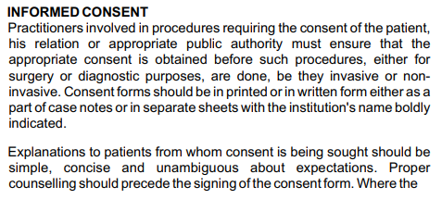
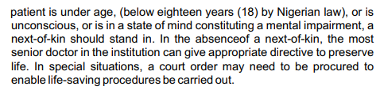
Medical Liability and the Law
CONSENT

Slide 34
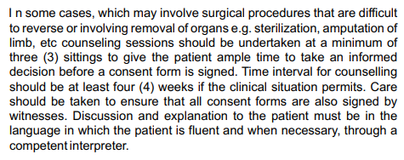
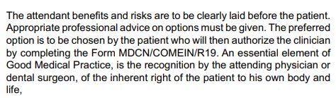
Medical Liability and the Law
CONSENT

Slide 35
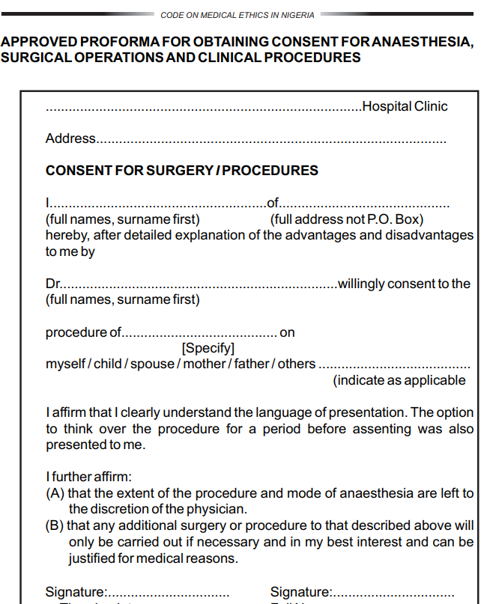
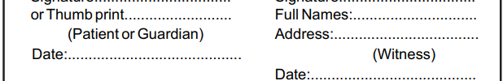
Medical Liability and the Law
Consent Form
Invited Comments as Lawyers

Slide 36
Medical Liability and the Law
Mitigating Medical Liability
Healthcare professionals can take proactive steps to reduce medical liability risks.
This includes
  maintaining accurate and detailed medical records
  adhering to proper documentation practices
  effective communication with patients
  engaging in shared decision-making
  participating in ongoing professional education and training
Example
A physician who consistently maintains detailed records of patient consultations, diagnoses, treatment plans, and discussions about potential risks and benefits demonstrates a commitment to mitigating liability.

Slide 37
Medical Liability and the Law
The Law

Slide 38
Medical Liability and the Law
The Doctor before the Courts
For Alleged Criminal Offence(s)

Slide 39
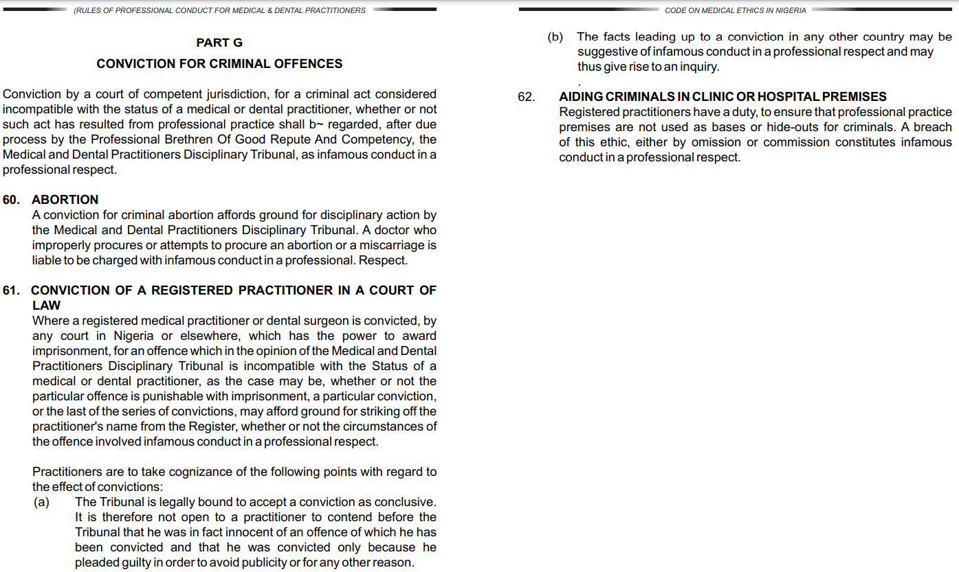
Medical Liability and the Law

Slide 40
Medical Liability and the Law
The Doctor before the Courts For Malpractice
Doctors convicted for criminal offences are more likely to be erased from the Medical Register for Infamous Conduct (or for bringing the profession into disrepute)
Sexual Offences
Lack of Insight
Dishonesty

Slide 41
Medical Liability and the Law
Anatomy of a Case

Slide 42
Medical Liability and the Law
2018
Patient 16-year-old visiting on holidays from the USA
Patient injured while playing basketball
2021
Dr Orji was to be arraigned and tried before the MDCN Disciplinary Tribunal in 2021, for the negligent and poor handling of his patient, Somtochukwu Ezi-Ashi
Three attempts were stalled by his absence on a claim of ill health.
He further stalled the case by filing an enforcement of fundamental right suit against the Tribunal at the High Court of the Federal Capital Territory

Slide 43
Medical Liability and the Law
While the professional case stalled at the Medical and Dental Practitioners’ Disciplinary Tribunal, the Director of Public Prosecution, Lagos State continued with the prosecution of the criminal charge against Orji at the Lagos State High Court:
The State Of Lagos V. Dr. Ejike Ferdinand Orji [Unreported Decision In Suit LD/8963C/2019]
February 2022
Re-arraigned on
  One count of causing grievous bodily harm to Ezi-Ashi
  Two counts of endangering human life through reckless and negligent acts
  Three counts of breach of duty of person doing dangerous acts and endangering human life through reckless and dangerous acts in violation of sections 245, 251(1)(e), 209, 211 and 251(1)(e) respectively of the Criminal Law of Lagos State Cap C17 Laws of Lagos State 2015.

Slide 44
Medical Liability and the Law
Anatomy of a case that encompasses the aspects of Tort
The State Of Lagos V. Dr. Ejike Ferdinand Orji [Unreported Decision In Suit LD/8963C/2019]
INTRODUCTION
On 20th January 2023, Honourable Justice A. A Akintoye, sitting at the High Court of Lagos State ("the Trial Court") delivered judgment in respect of a criminal charge of medical negligence preferred against one Dr Ejike Ferdinand Orji ("the Defendant").
The Trial Court, in its well-reasoned judgment, found the Defendant liable for recklessness and negligence in the provision of medical care and services that unfortunately led to the deformity of the left limb/leg of his patient, one Master Somi Ezi-ashi ("Somi" or "the Patient").

Slide 45
Medical Liability and the Law
Anatomy of a case that encompasses the aspects of Tort
SUMMARY OF FACTS
Patient, Somi, injured his left leg whilst playing basketball on July 26, 2018
Taken to Excel Children Medical Centre, Lagos ("the hospital" or "the facility") by patient’s friend and a police officer for medical attention on the instruction of Somi's mother
Mother arrived soon after
Mr. Emmanuel and Mr. Makinde assisted in carrying Somi into the Defendant's theatre room.
The Defendant then instructed the police office and patient’s friend to wait behind in the theatre to assist him further
The Defendant gave both non-medical personnels surgical gloves to wear, which they did.
The Defendant thereafter injected Somi with sedatives and thereby put him to sleep.
Thereafter, the Defendant instructed Mr. Emmanuel and Mr. Makinde to pull Somi's leg from the upper thigh and the lower part of the leg respectively to enable him to reset Somi's leg

Slide 46
Medical Liability and the Law
Anatomy of a case that encompasses the aspects of Tort
The State Of Lagos V. Dr. Ejike Ferdinand Orji [Unreported Decision In Suit LD/8963C/2019]
Defendant wrapped Somi's leg with a fiber glass cast.
Somi's mother was surprised why Somi's leg was completely encased in a cast, even before an x-ray was carried out to determine the nature and severity of the
Somi woke up complaining of excruciating pains and burning sensations caused by the tightness of the cast on his leg.
After the x-ray was done, Somi and his mother returned to the Defendant's facility, but the Defendant was not available at the hospital.

Slide 47
Medical Liability and the Law
Anatomy of a case that encompasses the aspects of Tort
The State Of Lagos V. Dr. Ejike Ferdinand Orji [Unreported Decision In Suit LD/8963C/2019]
Somi kept complaining of the tightness of the cast.
Somi's mother complained to the Defendant on the phone that Somi was going through excruciating pain and The Defendant dismissed her concerns stating that the tightness of the cast will reduce in two days and that Somi should return to the hospital in two (2) weeks' time.
On the night of the injury, 26th July 2018, Somi was unable to sleep throughout the night as the cast was too tight and he was in excruciating pain.

Slide 48
Medical Liability and the Law
Anatomy of a case that encompasses the aspects of Tort
The State Of Lagos V. Dr. Ejike Ferdinand Orji [Unreported Decision In Suit LD/8963C/2019]
Next day, July 27, 2018, Somi and his mother returned to the Defendant's facility where they met the Defendant.
Somi's mother reiterated that Somi was experiencing excruciating pains and had in fact not slept throughout the night because the cast was too tight. The Defendant examined Somi and indeed confirmed that there was too much pressure on his left leg. However, rather than completely remove the tight cast on Somi's leg, the Defendant, cut a square patch off the cast at the back of Somi's upper thigh, which he said would relieve the tightness

Slide 49
Medical Liability and the Law
Anatomy of a case that encompasses the aspects of Tort
The State Of Lagos V. Dr. Ejike Ferdinand Orji [Unreported Decision In Suit LD/8963C/2019]
Day 5, July 30, 2018, Somi was rushed to another hospital and after series of tests, Somi was found to have developed compartment syndrome caused by the tight cast.
Blood supply and oxygen had been cut off from Somi's leg. The leg was now in danger being Somi had to undergo surgery to stand any chance of saving his leg.
Between 2nd -10th August, Somi had six (6) surgeries performed on his left leg to correct the damage caused by the tight cast. During this period, the Defendant never contacted Somi's parents to ask about Somi's wellbeing.

Slide 50
Medical Liability and the Law
Anatomy of a case that encompasses the aspects of Tort
The State Of Lagos V. Dr. Ejike Ferdinand Orji [Unreported Decision In Suit LD/8963C/2019]
On arriving home, Somi called his mother's attention to a smelly and sticky liquid oozing from the square/window which the Defendant had
Somi's mother and father immediately took Somi back to the Defendant's facility to be examined.
After much persuasion, the Defendant reluctantly removed the tight cast on Somi's leg and covered the leg with bandage. By the time the cast was removed, Somi's leg was about twice or thrice the size of his regular leg before the cast was applied.
Day 3, July 28, 2018, Somi was discharged and went home with his mother but the pain in his leg continued unabated.
Day 4, July 29, 2018, Somi's mother noticed that there was substantial liquid accumulating on Somi's left leg above the bandage which was wrapped around part of his
By this time, Somi had begun to run a high temperature and felt extremely uncomfortable.

Slide 51
Medical Liability and the Law
Anatomy of a case that encompasses the aspects of Tort
The State Of Lagos V. Dr. Ejike Ferdinand Orji [Unreported Decision In Suit LD/8963C/2019]
Day 5, July 30, 2018, Somi was rushed to another hospital and after series of tests, Somi was found to have developed compartment syndrome caused by the tight cast. Blood supply and oxygen had been cut off from Somi's leg. The leg was now in danger being Somi had to undergo surgery to stand any chance of saving his leg.
Between 2nd -10th August, Somi had six (6) surgeries performed on his left leg to correct the damage caused by the tight cast. During this period, the Defendant never contacted Somi's parents to ask about Somi's wellbeing.

Slide 52
Medical Liability and the Law
Anatomy of a case that encompasses the aspects of Tort
The State Of Lagos V. Dr. Ejike Ferdinand Orji [Unreported Decision In Suit LD/8963C/2019]
Day 9, 10th August 2018, Somi flown to the United States for further medical
  Somi was admitted and hospitalized for about three weeks at the Hospital where he had six (6) additional surgeries, bringing the total number of surgeries he on the left leg to twelve (12). He was discharged on the 5th of September 2018, and he left the hospital in a wheelchair.
By an Amended Charge dated 4th February 2022, the Attorney General of Lagos State preferred a 6 (six) count charge against the The charges include- causing grievous bodily harm, endangering human life through reckless and negligent acts, breach of duty of person doing dangerous acts and endangering human life through reckless and dangerous acts contrary the Criminal Law of Lagos State, 2015.

Slide 53
Medical Liability and the Law
Anatomy of a case that encompasses the aspects of Tort
The State Of Lagos V. Dr. Ejike Ferdinand Orji [Unreported Decision In Suit LD/8963C/2019]
SYNOPSIS OF THE JUDGMENT OF THE TRIAL COURT
ON THE CHARGE OF CAUSING GRIEVOUS BODILY HARM
From case law analysis, the Trial Court identified the elements of grievous bodily harm which are
(1) that the accused person by act caused bodily pain, disease or infirmity to the complainant
(2) that he did so intentionally with the knowledge that it was likely to cause the harm
On the first element as to whether the Defendant caused bodily pain, disease or infirmity on Somi, the court analysed the testimony of Somi (PW10) and his mother (PW3) who both testified that Somi was in excruciating pain and was crying due to the tightness of the cast
The Court also analysed the expert opinion of orthopaedic surgeons (PW4, PW6, PW7 and PW8) who testified that the Defendant should have yanked off the cast as soon as Somi complained of the tightness of the cast.
The Trial Court therefore found that the action of the Defendant in applying a cast tightly did cause bodily pain and infirmity to Somi

Slide 54
Medical Liability and the Law
Anatomy of a case that encompasses the aspects of Tort
The State Of Lagos V. Dr. Ejike Ferdinand Orji [Unreported Decision In Suit LD/8963C/2019]
SYNOPSIS OF THE JUDGMENT OF THE TRIAL COURT
ON THE CHARGE OF CAUSING GRIEVOUS BODILY HARM
From case law analysis, the Trial Court identified the elements of grievous bodily harm which are
(1) that the accused person by act caused bodily pain, disease or infirmity to the complainant
(2) that he did so intentionally with the knowledge that it was likely to cause the harm
On the second requirement of establishing intention to cause harm or hurt, the Trial Court found that it was not satisfied that the Defendant acted intentionally or with the knowledge that it was likely to cause harm/hurt to the patient
Having failed to prove the elements of grievous bodily harm, the Trial Court found the Defendant NOT GUILTY of the offence of causing grievous bodily harm to Somi

Slide 55
Medical Liability and the Law
Anatomy of a case that encompasses the aspects of Tort
The State Of Lagos V. Dr. Ejike Ferdinand Orji [Unreported Decision In Suit LD/8963C/2019]
ON THE CHARGE OF ENDANGERING HUMAN LIFE THROUGH RECKLESS AND DANGEROUS ACT
The Trial Court analysed the testimony of Mr. Emmanuel (PW1) and Mr. Makinde (PW2) who both testified that the Defendant instructed them to pull Somi's leg so that he can reset it. The Court found that, neither Emmanuel nor Makinde was trained personnel of the hospital.
They were police officer and basketball coach respectively who were present when Somi sustained the injury. The court found that the Defendant was reckless and negligent in using untrained and non- medical personnel in administering treatment on Somi
In providing expert opinion, PW8, an orthopaedic surgeon from LASUTH testified that a fracture cannot be manipulated unless there is a diagnosis to ascertain the configuration and amount of displacement. The evidence before the Trial Court according to PW4, PW6, PW7 and PW8 (all orthopaedic surgeons) is that the cast should not have been placed on Somi's leg in the first place before the Defendant had done an x-ray to ascertain the nature of Somi's injury.

Slide 56
Medical Liability and the Law
Anatomy of a case that encompasses the aspects of Tort
The State Of Lagos V. Dr. Ejike Ferdinand Orji [Unreported Decision In Suit LD/8963C/2019]
ON THE CHARGE OF ENDANGERING HUMAN LIFE THROUGH RECKLESS AND DANGEROUS ACT
The Trial Court also referred to the statements of the medical doctors in the panel of Medical and Dental Investigative Panel Report dated 15th March
All the medical doctors, in that investigative report, questioned the urgency that necessitated the Defendant to apply cast without carrying out a scan or x-ray on the injury.

Slide 57
Medical Liability and the Law
Anatomy of a case that encompasses the aspects of Tort
The State Of Lagos V. Dr. Ejike Ferdinand Orji [Unreported Decision In Suit LD/8963C/2019]
ON THE CHARGE OF ENDANGERING HUMAN LIFE THROUGH RECKLESS AND DANGEROUS ACT
On the question of the tightness of the cast, the Trial Court relied on the uncontroverted testimony of Somi (PW10) who testified that the tightness of the cast caused him excruciating pain
Somi's testimony was confirmed by the testimony of his parents who asked the Defendant to remove the tight cast.
The Court also relied on the expert testimony of PW4, PW6, PW7 and PW8 (all orthopaedic surgeons), who testified that the cast should have been removed when Somi complained about the tightness of the cast and of being in pain

Slide 58
Medical Liability and the Law
Anatomy of a case that encompasses the aspects of Tort
The State Of Lagos V. Dr. Ejike Ferdinand Orji [Unreported Decision In Suit LD/8963C/2019]
ON THE CHARGE OF ENDANGERING HUMAN LIFE THROUGH RECKLESS AND DANGEROUS ACT
On the question of consent, Somi's mother (PW3) testified that the Defendant failed to seek her consent before treating her son
PW8, an orthopaedic surgeon, testified that - "Before any procedure is carried out, we obtain what we refer to as informed consent which requires explaining in details to whoever immediately is concerned, what the procedure is, the pros and cons, the possible implications and at the end of the day they have to sign off on a sheet of paper stating that they give us express permission to perform the procedure"

Slide 59
Medical Liability and the Law
Anatomy of a case that encompasses the aspects of Tort
The State Of Lagos V. Dr. Ejike Ferdinand Orji [Unreported Decision In Suit LD/8963C/2019]
ON THE CHARGE OF ENDANGERING HUMAN LIFE THROUGH RECKLESS AND DANGEROUS ACT
In its final analysis, the court found that there was no iota of evidence before it showing that the Defendant obtained the informed consent of Somi's mother (PW3) before applying a cast on Somi's leg
The Trial Court held that the Defendant's acts were negligent and reckless and that his negligent and reckless acts did cause great harm and endangered the life of the patient
The Trial Court found the Defendant GUILTY

Slide 60
Medical Liability and the Law
Anatomy of a case that encompasses the aspects of Tort
The State Of Lagos V. Dr. Ejike Ferdinand Orji [Unreported Decision In Suit LD/8963C/2019]
ON THE CHARGE OF BREACH OF DUTY BY APERSON DOING DANGEROUS ACT AND ENDANGERING HUMAN LIFE THROUGH RECKLESS AND DANGEROUS ACTS
There was evidence before the court that the Defendant was not trained as an orthopaedic surgeon. In fact, by his own admission, the Defendant stated that he is a paediatrician
From the expert testimony of all the orthopaedic surgeons, the court found that a trained orthopaedic surgeon would know not to apply a cast without knowing what the injury was. In this case, the Defendant applied a cast not being an orthopaedic surgeon and not under the supervision of an orthopaedic surgeon.
The Trial Court held that the Defendant did not exercise reasonable skill or care when he applied a cast on Somi's leg without first having an x-ray to ascertain the nature of injury sustained
The court held that the Defendant undertook to administer medical treatment which turned out to be injurious to the health of Somi and the Defendant did not exercise reasonable skill and care. The Trial Court found the Defendant GUILTY.

Slide 61
Medical Liability and the Law
Anatomy of a case that encompasses the aspects of Tort
The State Of Lagos V. Dr. Ejike Ferdinand Orji [Unreported Decision In Suit LD/8963C/2019]
ON THE CHARGE OF BREACH OF DUTY BY UNLAWFULLY INFLICTING SEVERE INJURY ON SOMI’S TOE
The Trial Court held that the Prosecution has not proved that the Defendant inflicted a severe wound on Somi's toe and concealed the resultant wound
No evidence was given to prove that the Defendant used a saw blade to lacerate Somi's toe and then proceeded to conceal the resultant wound from anyone.
The act of cutting the cast cannot be said to be a dangerous act to human life or health.
Overall, the Prosecution's evidence as to this charge is not clear. Hence, there is no evidence that the Defendant carried out any unlawful act in this instance or that such act was dangerous to human life. The Trial Court found the Defendant NOT GUILTY.

Slide 62
Medical Liability and the Law
Anatomy of a case that encompasses the aspects of Tort
The State Of Lagos V. Dr. Ejike Ferdinand Orji [Unreported Decision In Suit LD/8963C/2019]
ON THE CHARGE OF BREACH OF DUTY BY THE DEFENDANT IN REFUSING TO REMOVE THE TIGHTCAST WHICH RESULTED IN COMPARTMENT SYNDROME
The evidence before the Court shows that the Defendant wilfully refused to promptly remove the tight cast despite repeated complaint of pain and tightness by Somi and his mother
An orthopaedic surgeon (PW4) testified before the court that once a patient complains of pain, he would immediately remove the cast as failure to remove it could risk the patient's life or It could lead to a blockage of the arteries which could eventually lead to amputation as potassium and calcium would have leaked out.
PW4 further testified that Somi had suffered a fracture of the tibia avulsion which was compounded by the tight application of the cast leading to compartment syndrome which is a chronic pain caused by dangerous building up of pressure.

Slide 63
Medical Liability and the Law
Anatomy of a case that encompasses the aspects of Tort
The State Of Lagos V. Dr. Ejike Ferdinand Orji [Unreported Decision In Suit LD/8963C/2019]
ON THE CHARGE OF BREACH OF DUTY BY THE DEFENDANT IN REFUSING TO REMOVE THE TIGHTCAST WHICH RESULTED IN COMPARTMENT SYNDROME
PW8, another orthopaedic surgeon, testified that if a tight cast is not removed timeously, the toe begins to tingle and after a while, there is no movement and may result in compartment syndrome within 4-6 hours
He testified that, if the tight cast is not removed within 12 hours, there may be irreparable damage to muscles and tissues.
The Witness for the Defence also confirmed the 4-6 hours timeline before compartment syndrome set in. The Court found that the Defendant had every opportunity to promptly remove the tight cast but failed to do so.

Slide 64
Medical Liability and the Law
Anatomy of a case that encompasses the aspects of Tort
The State Of Lagos V. Dr. Ejike Ferdinand Orji [Unreported Decision In Suit LD/8963C/2019]
ON THE CHARGE OF BREACH OF DUTY BY THE DEFENDANT IN REFUSING TO REMOVE THE TIGHTCAST WHICH RESULTED IN COMPARTMENT SYNDROME
In sum, the court found the Defendant to have committed a breach of his professional duty as a medical doctor when he wilfully refused to promptly remove the tight fiber glass cast on Somi's leg despite complaints of severe pain which therefore resulted in compartment syndrome. The Trial Court found the Defendant GUILTY.
The Trial Court found the Defendant guilty and accordingly convicted him in respect of Counts 2, 3, 4 and 6 of the Charge. Upon listening to the plea of leniency made by the Defendant's Counsel, the Trial Court sentenced the Defendant to one (1) year imprisonment for each of the Count
The sentences were to run concurrently

Slide 65
Medical Liability and the Law
Anatomy of a case that encompasses the aspects of Tort
The State Of Lagos V. Dr. Ejike Ferdinand Orji [Unreported Decision In Suit LD/8963C/2019]
ETHICAL ISSUES
Negligence: Medical negligence refers to the failure of healthcare providers to fulfil their professional obligations, breaching the duty of care and not exercising reasonable degree of skill
The Medical and Dental Council of Nigeria (MDCN), pursuant to the powers conferred on it by the Medical and Dental Practitioners Act 20042 issued a Code of Medical Ethics in Nigeria 2008 ("the Code"). The Code, which codifies the rules of professional conducts for medical practitioners also regulates the conducts/activities of medical practitioners in Nigeria.
For instance, the Code states that all medical practitioners and dental surgeons owe a duty of care to their patients in every professional relationship.
A careful consideration of the provision of the Code clearly shows several malpractices perpetuated by the Defendant in this case
For instance, the Code requires that a medical practitioner shall not delegate any exclusive professional medical responsibility to any non-medical person. In this case, the Trial Court was right when it found that Defendant was professional negligent by using a police officer and a basketball coach (non-medical personnel) to reset the patient's leg.

Slide 66
Medical Liability and the Law
Anatomy of a case that encompasses the aspects of Tort
The State Of Lagos V. Dr. Ejike Ferdinand Orji [Unreported Decision In Suit LD/8963C/2019]
ETHICAL ISSUES
As lives are at stake when providing medical treatment, it is mandatory that a medical practitioner diagnose the situation by carrying out the relevant tests before attempting a line of treatment.
A medical practitioner is professionally negligent, where he manifests incompetence in the assessment of a patient, as in the instant case.
The findings of the court that the failure of the Defendant to carry an x-ray to ascertain the nature of the injury sustained by the patient is reckless and negligent, is therefore apt and unassailable.

Slide 67
Medical Liability and the Law
Anatomy of a case that encompasses the aspects of Tort
The State Of Lagos V. Dr. Ejike Ferdinand Orji [Unreported Decision In Suit LD/8963C/2019]
Informed Consent
Before performing any invasive test or providing medical treatment, doctors must obtain permission from a competent patient in a manner that is informed and voluntary. The process is known as informed consent. People have the right to information about risks, benefits, and alternative treatments when making decisions about medical care and the freedom to choose.
Informed consent to treatment is fundamental to ethics and law.
Competence to give informed consent usually connotes mental capacity and age of majority recognized in that jurisdiction to make medical decisions. As in the instant case, where the patient (Somi) was 16 years old, at the time, the Code of Medical Ethics in Nigeria, 2008 permits the next-of-kin to provide such consent.

Slide 68
Medical Liability and the Law
Anatomy of a case that encompasses the aspects of Tort
The State Of Lagos V. Dr. Ejike Ferdinand Orji [Unreported Decision In Suit LD/8963C/2019]
Informed Consent
Informed consent to treatment is fundamental to ethics and law.
The Code requires that practitioners involved in procedures requiring the consent of the patient, his relation or appropriate public authority must ensure that the appropriate consent is obtained before such procedures, either for surgery or diagnostic purposes, are done, be they invasive or non-invasive.
In the case under review, the evidence before the court reveals that the Defendant failed to obtain the consent of the patient's mother (PW3) before applying a fiber glass cast on the patient's leg.
The argument of the Defence that informed consent is unnecessary where the medical intervention is non-invasive (such as, in cast application), was discountenanced by the court in the face of the clear provision of Rule 19 of the Code that mandates the obtaining of informed consent in both invasive and non-invasive medical treatment.

Slide 69
Medical Liability and the Law
Anatomy of a case that encompasses the aspects of Tort
The State Of Lagos V. Dr. Ejike Ferdinand Orji [Unreported Decision In Suit LD/8963C/2019]
Specialist Assistance and Referral
It is important that a medical practitioner who does not believe they have a requisite skill for a certain ailment either refer a patient to another physician or seek another colleague's opinion to help pin- point diagnosis and line of treatment.
In the instant case, where the Defendant was not a trained or qualified Orthopaedic specialist, he is obligated to refer the patient (Somi) to an orthopaedic surgeon for proper treatment.
This act of the Defendant contravenes Rule 28(G) of the Code. If the Defendant in this case had referred the patient before starting treatment, the patient's injuries might not have escalated as it did.

Slide 70
Medical Liability and the Law
Anatomy of a case that encompasses the aspects of Tort
The State Of Lagos V. Dr. Ejike Ferdinand Orji [Unreported Decision In Suit LD/8963C/2019]
Standardized Due Process and Ethical Standards: It is preferable to medical professionals to follow accepted standards of medical practice which are based on credible evidence published in peer-reviewed medical literature generally recognized by the relevant medical community, physician specialty society recommendations, and/or the view of physicians practicing in relevant clinical areas and any other relevant.
These may include, clinical policy statements, standards of practice, standard operating procedures, clinical practice protocols, clinical procedures, amongst others.
The Defendant in this case did not follow the accepted Standards of Medical Practice, as all other doctors in their oral testimony agreed that an X-ray must be done before any line of treatment carried out and that the Defendant should have suspected something wrong such as compartment syndrome when the patient complained of pain and tightness of the cast.
Following accepted medical standards and guidelines help prevent injury to a patient and whatever liability that might follow.

Slide 71
Medical Liability and the Law
Anatomy of a case that encompasses the aspects of Tort
The State Of Lagos V. Dr. Ejike Ferdinand Orji [Unreported Decision In Suit LD/8963C/2019]
CONCLUSION
The above case analysis therefore provides an overview of certain concepts in medical practice and how they may give rise to culpability. In the context of the decision of the Trial Court, it is instructive to mention that medical practitioners, like any other professional, are not immune from criminal prosecution for reckless or negligent conducts.
Medical professionals can be prosecuted for obvious misconducts committed while carrying out their professional duties.
It is expected that the decision of the court in this case will not only operate as deterrent to professionals generally but will also sensitise the public on their rights as a patient visiting an hospital.

Slide 72
Medical Liability and the Law
Anatomy of a case that encompasses the aspects of Tort
The State Of Lagos V. Dr. Ejike Ferdinand Orji [Unreported Decision In Suit LD/8963C/2019]
CONCLUSION
The above case analysis provides an overview of certain concepts in medical practice and how they may give rise to culpability.
In the context of the decision of the Trial Court, it is instructive to mention that medical practitioners, like any other professional, are not immune from criminal prosecution for reckless or negligent conducts.
Medical professionals can be prosecuted for obvious misconducts committed while carrying out their professional duties.
It is expected that the decision of the court in this case will not only operate as deterrent to professionals generally but will also sensitize the public on their rights as a patient visiting an hospital.

Slide 73
Medical Liability and the Law
Doctor jailed for 4 years; will serve one year
Why was this case successful after 5 years?

Slide 74
Medical Liability and the Law
Four Doctors suspended over misconduct
Bose Adelakun, September 5, 2023; https://nationaltelescope.com/four-doctors-suspended-over-misconduct/
Four Doctors were suspended by the Medical and Dental Practitioners Investigation Panel of the Medical and Dental Council of Nigeria over misconduct.
The Investigation Panel, the statutory body with the mandate to investigate any case where it is alleged that a registered medical practitioner or dental surgeon has misbehaved in a professional respect.
The Medical and Dental Practitioners Investigation Panel ordered the Interim Suspension from the Medical Profession in Nigeria, of the following registered medical practitioners: 1. Dr. Ejike Ferdinand Orji. 2. Dr. Richard Chukwujekwu Okoye. 3. Dr. Olalekan Olatise. 4. Dr. Buliaminu Adebayo Adigun.
These registered practitioners are by this order not allowed to practice Medicine in Nigeria until the cases against them are determined by the Medical and Dental Practitioners Disciplinary Tribunal.
Notices of their suspension have been communicated to them and relevant institutions to enforce this order.

Slide 75
Medical Liability and the Law
Emerging Technologies

Slide 76
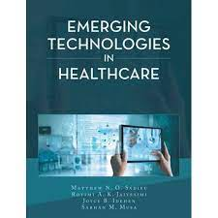
Medical Liability and the Law
Matthew N O Sadiku, Rotimi A K Jaiyesimi, Joyce B Idehen, Sarhan M Musa
(2021)

Slide 77
Medical Liability and the Law
Emerging Trends and Challenges in Medical Liability
The field of medical liability is continuously evolving due to advancements in healthcare technology, changes in legal standards, and societal expectations.
Emerging trends and challenges may include issues related to
  Telemedicine
  Electronic health records
  Genetic testing
  Artificial intelligence
  The changing landscape of healthcare regulations
Example
With the rise of telemedicine, the legal landscape surrounding medical liability is adapting to incorporate remote consultations, virtual diagnoses, and potential challenges regarding informed consent and standard of care in this context.

Slide 78
Medical Liability and the Law
Advocacy for Good Medical Practice

Slide 79

Medical Liability and the Law
The Medical Law Professionals Association of Nigeria (MELPAN)
An umbrella professional body for legal and healthcare practitioners in Nigeria with a world-class vision of excellence in promoting the study, research, and advocacy in medical law, health law, legal medicine, ethics, and practice as well as the advancement of health rights, international best practice, medico-legal jurisprudence, professional accountability and health policy reforms.

Slide 80
Medical Liability and the Law
Areas of interest in Nigerian Medical Practice
Dishonesty
Competence of the doctor _ Persistent poor outcomes
Practising outside one’s area of skill
Practising in facilities not registered or equipped for the complexity of the operation
Failure to obtain informed consent
Crossing professional boundaries with patients
Wilful neglect
Organ Harvesting

Slide 81
Medical Liability and the Law
Conclusion
■ No practitioner sets out to cause harm to patients
■ To err is human
■ However, a practitioner must practice to an acceptable standard to avoid facing malpractice and negligence claims
■ Place patient safety at the centre of your practice and involve them in decision-making
■ Caution is required by doctors who have a duty of care to patients
There are no winners in Medical Negligence

Slide 82
Medical Liability and the Law
Conclusion
Medical errors will happen because we are human
Doctors should adhere to the principles of good medical practice and in doing so reduce errors by omission or commission
Failure to adhere to practice with professionalism and safely may resort in patients seeking redress in the law courts
As lawyers, you have a significant role to play in attaining ‘justice’ for these patients who have come to harm

Slide 83
Medical Liability and the Law
Conclusion
This talk has highlighted the importance of understanding medical liability and the law
Medical malpractice lawyers investigate the claim
Medical expert witness provide reports to help the Court understand the events in the management of the patient
Cases of medical litigation is increasing in Nigeria
It is important that lawyers going into medico-legal practice should undertake medical courses to understand basic tenets of medicine
Doctors should undertake professional development and adherence to ethical standards to mitigate medical liability risks
Medical Law, through Case Law, is shaping how medicine is practiced

Slide 84
Medical Liability and the Law
Summary: Law of Tort
Claimant must prove on the balance of probabilities
Three elements in the tort of negligence
1. A Duty of Care
● Duty of Care starts when the patient sees the practitioner
2. Breach of the Duty of Care
● The medical reports prepared for the Courts by the Claimant’s and or Defendant’s point to aspects of the management that was a breach of the standard of care or otherwise
● The Courts decide on the weight of the evidence of the reports
3. Causation
The evidence shows that the damage experienced was as a result of the breach of the Standard of Care
4. Liability and Costs
Determined by the Courts, making references to Case Laws or establishing new approaches

Slide 85
Medical Liability and the Law
Each Nigerian life is priceless (Rotimi Jaiyesimi)
Doctors should practice professionally and safely
Doctors and Facilities must be regulated effectively
Regulators must protect patients
Lawyers with an interest in medical law should understand the medical specialty they represent patients
Erring doctors must be held accountable through the MDCN and Courts
Doctors must learn from mistakes through incident reporting and investigations
Nigeria should consider enacting a duty of candour

Slide 86
Medical Liability and the Law
Anatomy of a case that encompasses the aspects of Tort
The State Of Lagos V. Dr. Ejike Ferdinand Orji [Unreported Decision In Suit LD/8963C/2019]
Footnotes
1. Forbes Advisor, "Medical Negligence: Legal Definition & Examples"
https://www.forbes.com/advisor/legal/medical-malpractice/medical-negligence/ accessed 17th February 2023
2. Cap M8, Laws of the Federation of Nigeria, 2004
3. Rule 28 of the Code of Medical Ethics in Nigeria, 2008
4. Rule 9(L) of the Code of Medical Ethics in Nigeria, 2008
5. Rule 28(B) of the Code of Medical Ethics in Nigeria, 2008.
6. Charles Sabatino, "Informed Consent" https://www.msdmanuals.com/home/fundamentals/legal-and-ethical-issues/informed-consent accessed 22nd February 2023
7. Rule 19 of the Code of Medical Ethics in Nigeria, 2008
8. Law Insider, "Accepted Standards of Medical Practice" https://www.lawinsider.com/dictionary/accepted-standards-of-medical-practice accessed 17th February 2023
9. Science Direct, "Standard of Practice" https://www.sciencedirect.com/topics/nursing-and-health-professions/standard-of-practice accessed 17th February 2023

Slide 87
Medical Liability and the Law
Thank You

Slide 88

Medical Liability and the Law

Slide 89




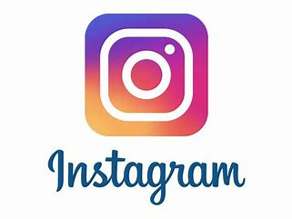
Medical Liability and the Law
jaiyesimi@obs-gyn.org
https://www.linkedin.com/in/professor-rotimi-jaiyesimi-9344335/
@nigerianshealth
https://www.nigerianhealthservice.com
https://trojanmedicgroup.com
rotimi_jaiyesimi_speaks

Slide 90
Medical Liability and the Law

